Slide 1


BOSCH’s Electric vehicle simulation

Slide 2


Vehicle Selection
The vehicle segment chosen here is 2- wheeler.
Reasons for choosing this segment:
01
The Indian road conditions that are narrow and congested make the two-wheelers preferable to avoid traffic congestion.
02
02
Two-wheelers sales are skyrocketed and they are more preferred by Indian Market (Proof)
Two wheeler sales in India from financial year 2011-2020
03
03
In major Indian cities, two-thirds of pollution load is due to two-wheelers. They give out 30% of the particulate matter load, 10% points more than the contribution from cars.

Slide 3

Performance Baselining
Equations and Assumptions
1. Vehicle weight with one passenger(M): 200 kg (Normal curb weight of 120 kg + passenger of 80 kg)
2. Gradeability : 5% (for urban driving)
3. Considered speed(V): 50 km/h (maximum allowable for scooter in city)
4. Frontal area(A_{f}): 0.65 m²
5. Coefficient of rolling resistance(μ_{r}): 0.004 (tyre on asphalt road)
6. Drag coefficient(C_{D}): 0.68
7. Air density(ρ): 1.2 (dry air density)
8. Wheel radius(r) : 8 in (0.2032 m)
9. Torque provided by wheel at maximum speed : 36.33 N-m
10. Single speed reduction ratio : 1.563

Slide 4
Performance Baselining
Calculated values:
Gradient resistance: M*g*sin(α) = 98 N
Rolling resistance: μ_{r}*M*g = 7.848 N
Aerodynamic resistance: 0.5*C_{D}*A_{f}*ρ*V² = 49.57 N
Total drag: 155.48 N (sum of the above three resistances)
Angular velocity of wheel: 68.3 rad/s
Time taken for reaching a speed of 50 km/h from rest : 22.957 s

Slide 5
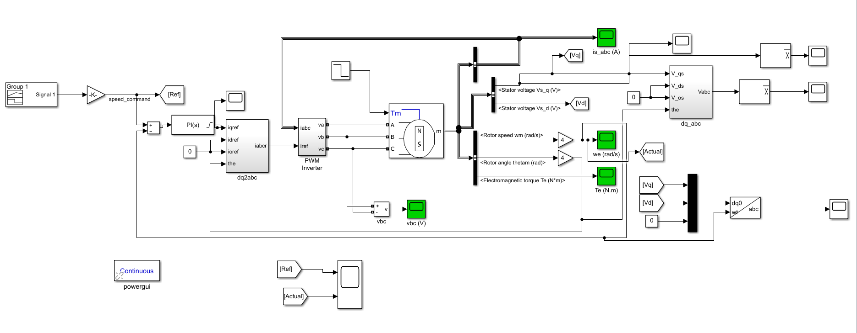
Modelling and Analysis
Simulink Model of the Motor Control System (Download here)

Slide 6
Modelling and Analysis
A brief description about each of the subsystems used:
PI controller: Controller used to reduce the error between reference speed and measured speed. The controller gains are estimated using the following expressions:
Kp = 2ξω₀L - R
Ki = ω₀² L
Where ω₀ is the natural frequency of the current closed-loop system (loop bandwidth) and ξ is the current loop attenuation.
dq2abc: Park and Clarke transformation

Slide 7
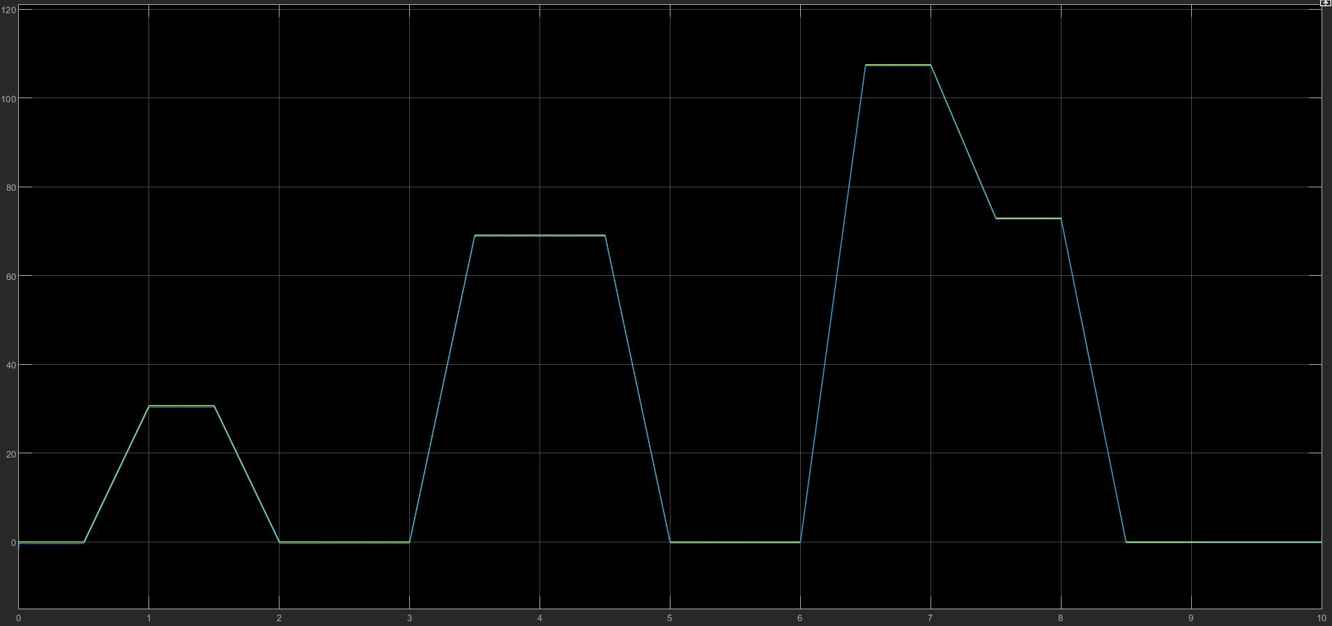
Modelling and Analysis: Speed Tracking

Slide 8
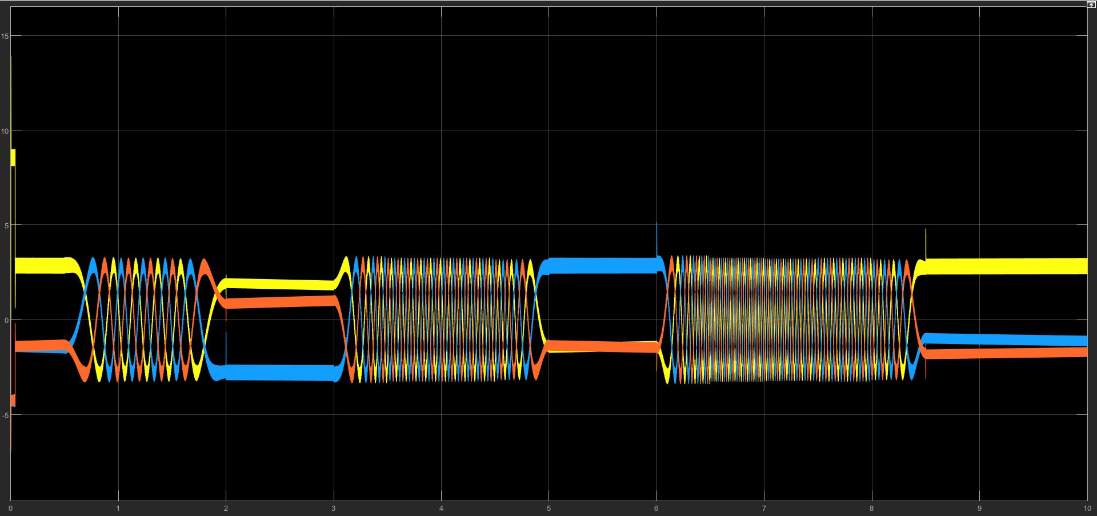
Modelling and Analysis: 3 Phase Currents

Slide 9
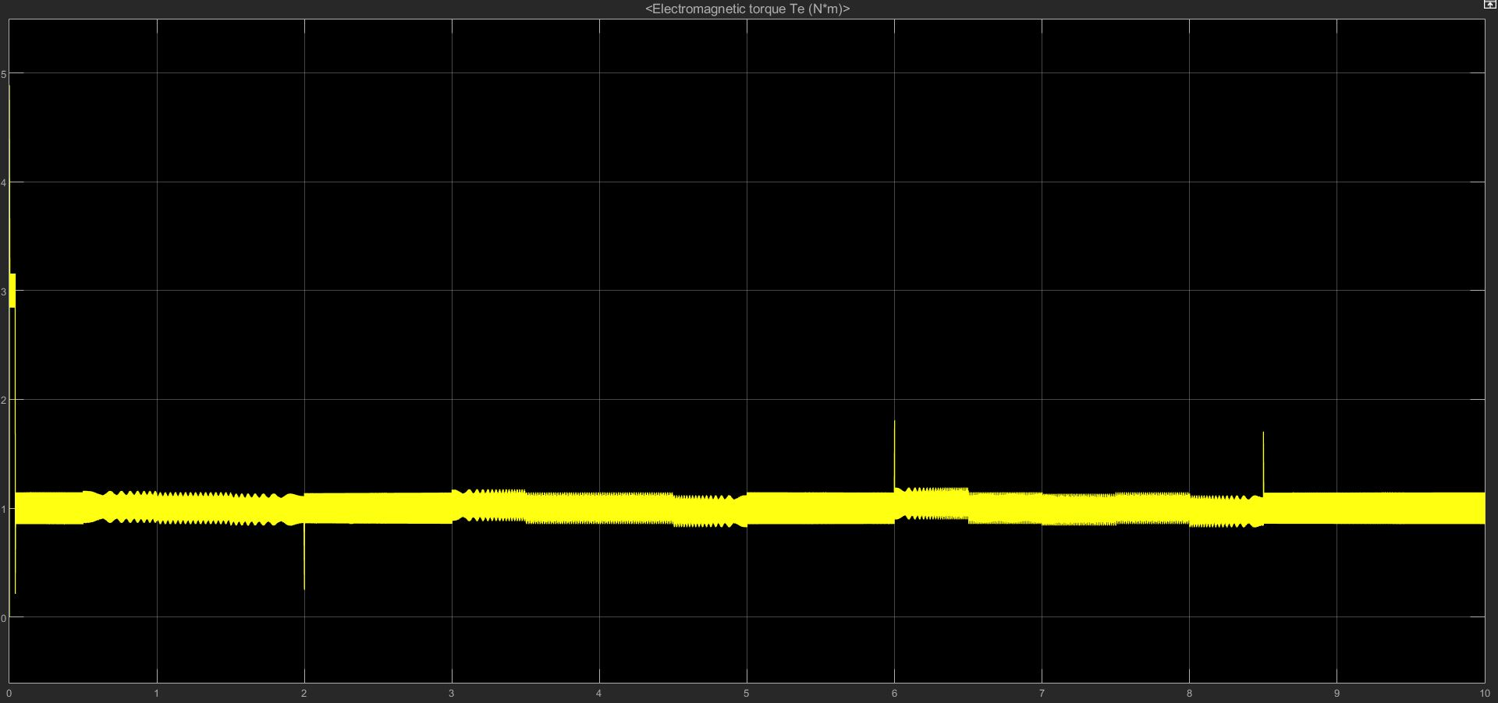
Modelling and Analysis: Torque

Slide 10
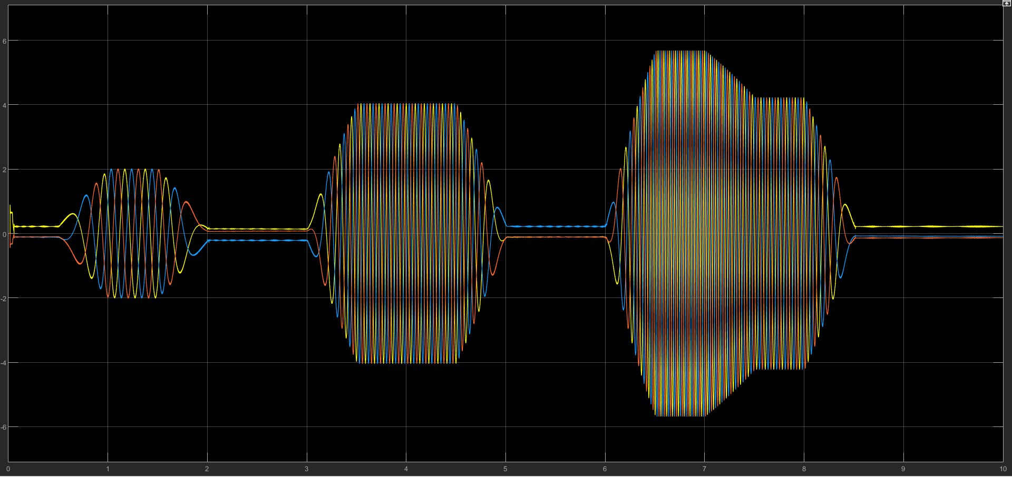
Modelling and Analysis: Avg Line Voltages

Slide 11
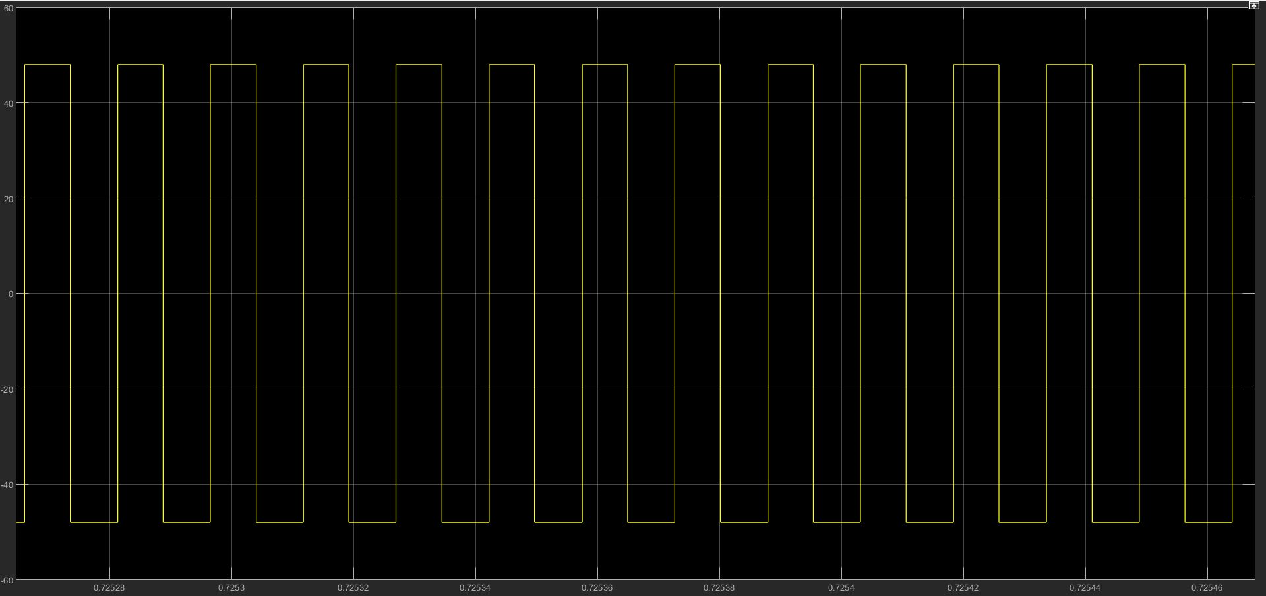
Modelling and Analysis: Line Voltage Vc

Slide 12
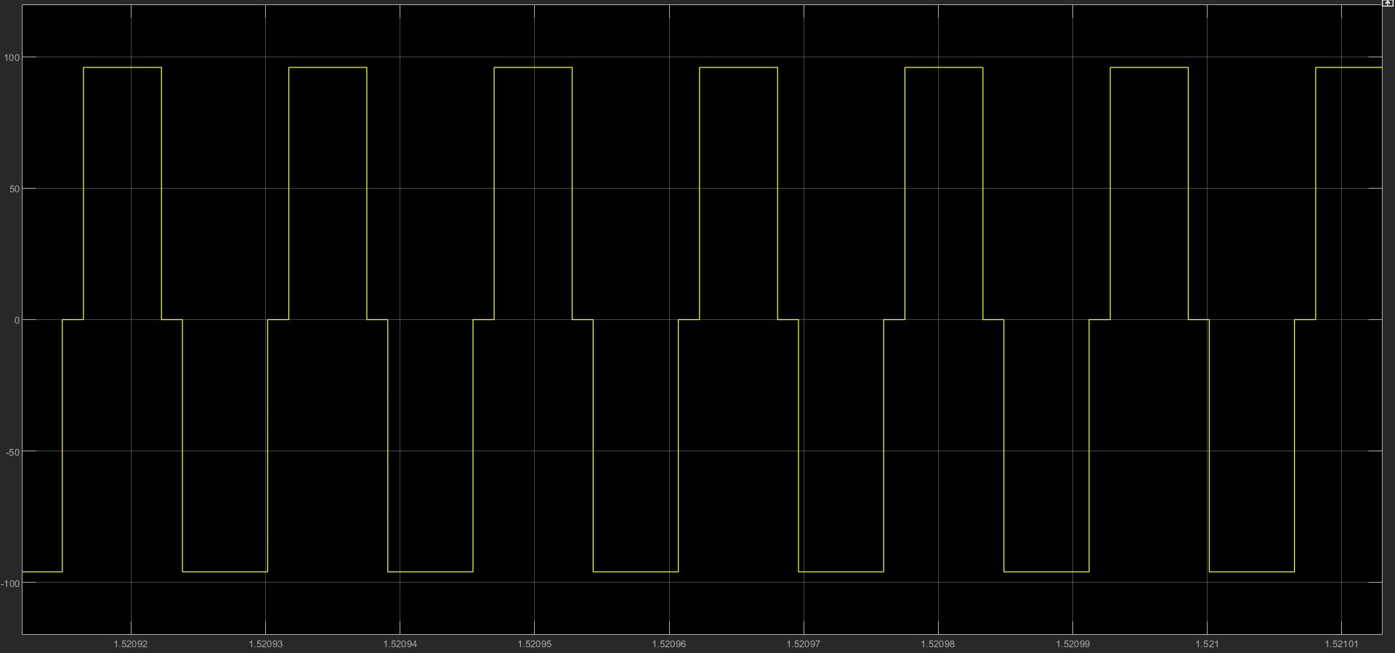
Modelling and Analysis: Phase Voltage

Slide 13
Electric Drive Dimensioning Motor Design: Assumptions
The following values have been assumed for the design of PMSM motor:
Battery voltage(V): 48V
Number of Poles(P): 8
Diameter of stator bore(D): 75 mm
Stator length(L): 52 mm
Magnetic Field Strength(B_{1g}): 0.4 T
Electrical Frequency(f): 50 Hz
Winding factor(k_{w}): 0.933
Length of air gap(l_{g}): 0.5 mm
Length of magnet(l_{m}): 2 mm
Carter coefficient(C): 1.7
Relative permeability of NdFeB(μ_{r}): 1.05
Slot Width Factor(SWF): 0.5
Slot Depth(SD): 12.3 mm
Slot space factor(f_{s}): 0.5

Slide 14
Electric Drive Dimensioning
Motor Design: Governing Equations
Rms value of linear current density K_{1s} = (P_{out} . 2p)/(πB_{1g}D²Lω_{s})
where p = number of pole pairs = 4 and ω_{s} = 2πf = 100π
Ampere turns per phase - N_{ph}I_{ph} = (K_{1s} .πD)/(6.k_{w} )
Current density J_{c} = K_{s}/f_{s}.SWF.SD
E_{ph}(rms) = ϵ.V/√3
N_{ph} = 2E_{ph}/(k_{w}B_{1g}DLω_{s})
I_{ph} = N_{ph}I_{ph} /N_{ph}

Slide 15
Electric Drive Dimensioning
Motor Design: Governing Equations
Cross-sectional area of conductor A_{c} = I_{ph}/J_{c}
L_{d} = 1.125πμ₀(N_{ph}/P)²(DL/g_{d})
(where g_{d} = C.l_{g} + l_{m}/μ_{r} and L_{d} = L_{q})
λ_{m} = (2N_{ph}B_{1g}DL)/(P/2)
R_{s} = 2N_{ph}.(ρL/A_{c} )
(where ρ = 0.0171 Ω-m/mm² assuming copper conductors)

Slide 16
Electric Drive Dimensioning Motor Design: Lookup Table
Motor Parameter | Value
R_{s} | 0.0775 Ω
L_{d} | 0.5523 mH
L_{q} | 0.5523 mH
λ_{m} | 0.0585 Wb turns

Slide 17
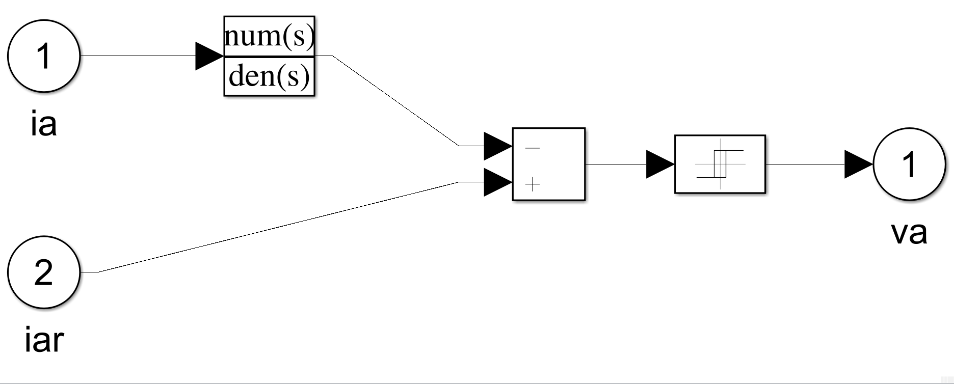
Electric Drive Dimensioning Inverter Design
3 Phase PWM Inverter has been used here with the following specifications:
DC Supply: 48V
Relay switching operation-
Switch on point: 0.05
Switch off point: -0.05
Output when on: 48
Output when off: -48
This inverter generates a square pulse.

Slide 18
Battery Dimensioning and Optimization: Driving Cycle
We will be considering the ECE R15 driving cycle for calculating the average energy per driving cycle. The parameters of the driving cycle are as follows:
Duration: 200s
Distance: 1.017 km
Max Speed: 13.88 m/s (50 km/h)
Average Speed: 5.085 m/s (18.306 km/h)
Min acceleration: 1.042 m/s
Max acceleration: -0.972 m/s²

Slide 19
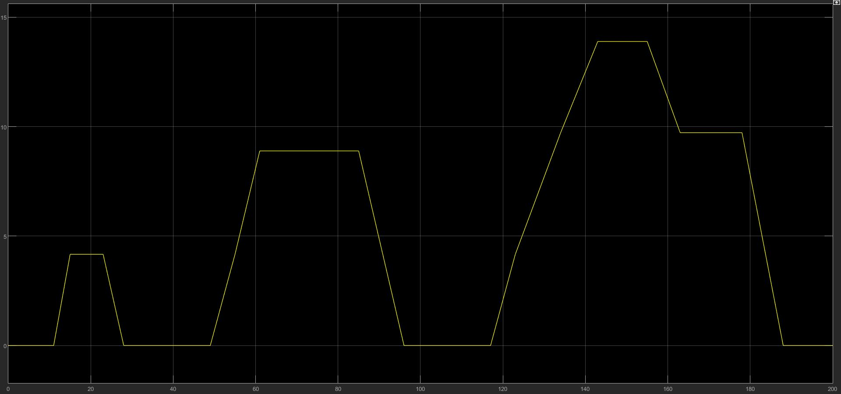
Battery Dimensioning and Optimization: Driving Cycle ECE R15

Slide 20
Battery Dimensioning and Optimization: Energy Consumption
The energy consumption is calculated based on the road loads. The total road load F_{tot} is the sum of the inertial force, road slope force, road load (friction) force and aerodynamic drag force.
The inertial force is the mass times instantaneous acceleration and the rest of the force expressions where calculated earlier.
Total Power P_{tot} = F_{tot} . v
Total energy consumption over the cycle E_{tot} = ∫F_{tot} . v .dt
(where v is the instantaneous vehicle speed)

Slide 21
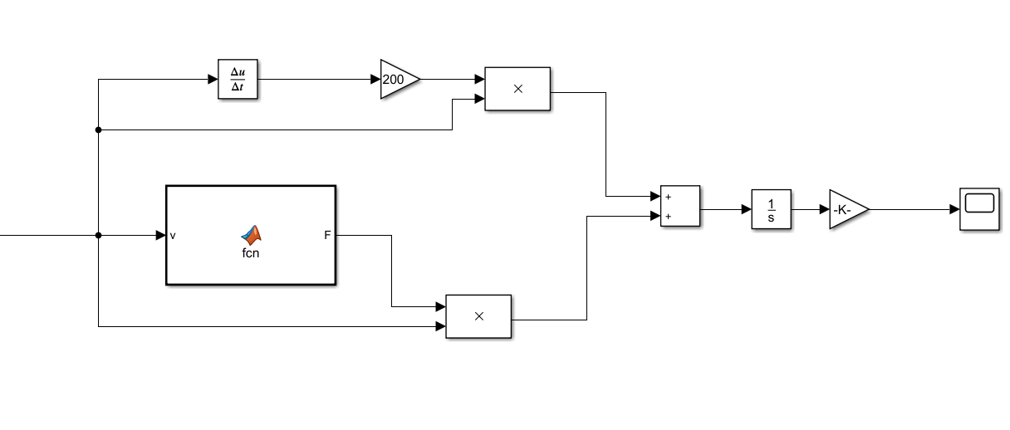
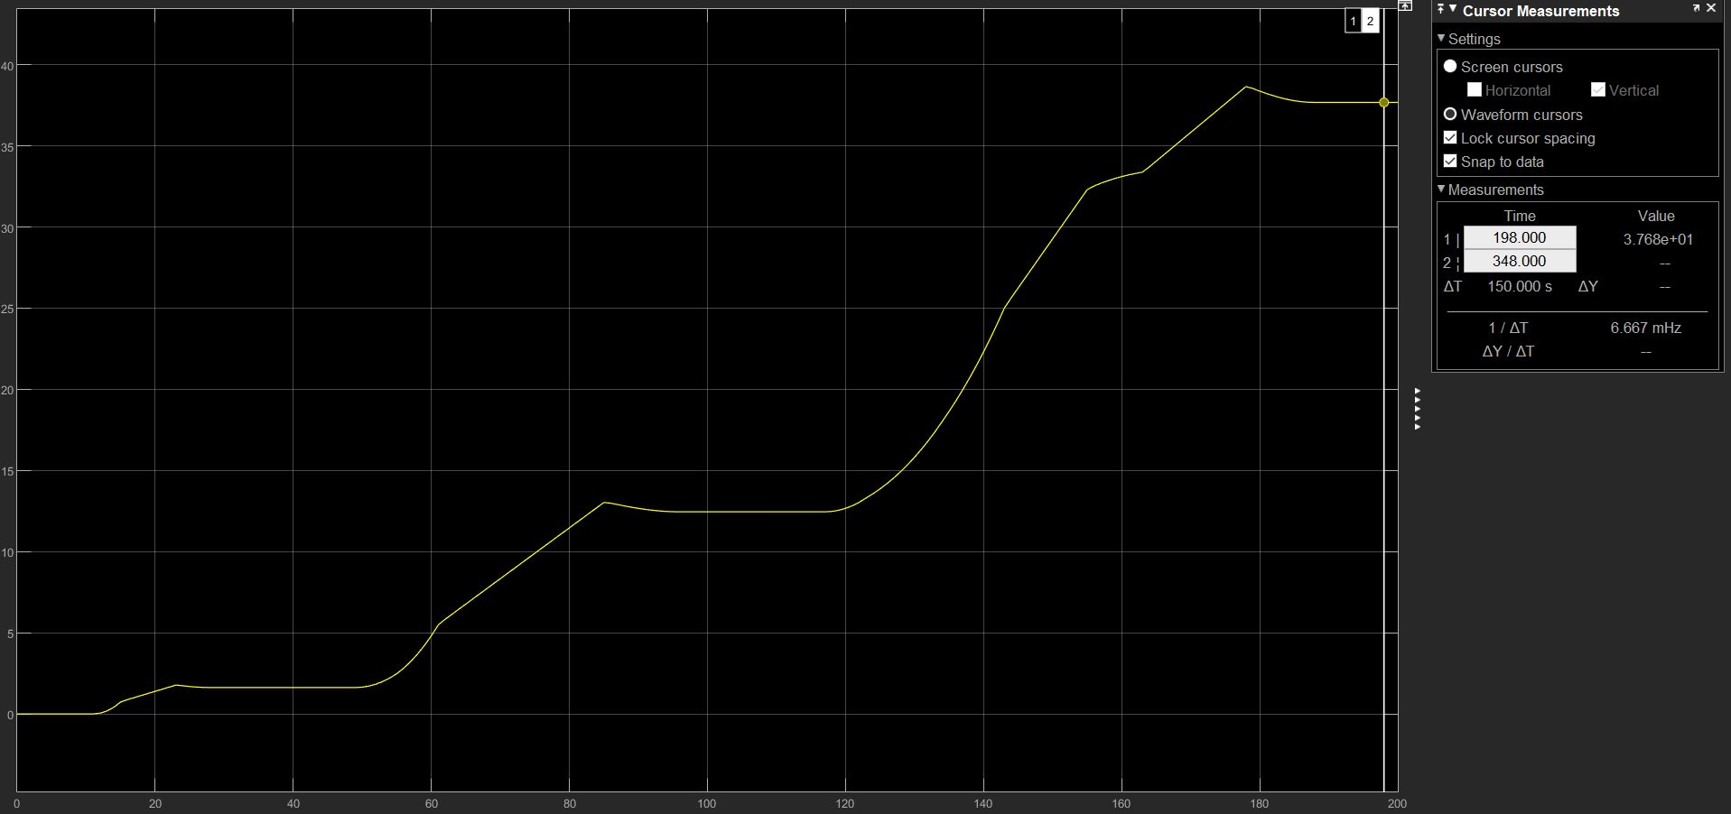
Battery Dimensioning and Optimization
Simulink Model for Calculating Energy Consumed

Slide 22
Battery Dimensioning and Optimization: Results
After doing the calculations using MATLAB Simulink model shown in the previous slide, the average energy per driving cycle = 37.7 Wh/km.
Assuming the target range to be 70 km, we arrive at a target battery size of 2639 Wh.
We use a combination of 238 cells(each of 11Wh) to make battery for our vehicle which will ensure better performance, fast charging and easy maintenance.
We will be using Li-ion Battery for its Efficiency and applications.

Slide 23
E/E Architecture
Battery
Throttle
Controller
PWM Inverter
PMSM
Gear
Wheel

Slide 24
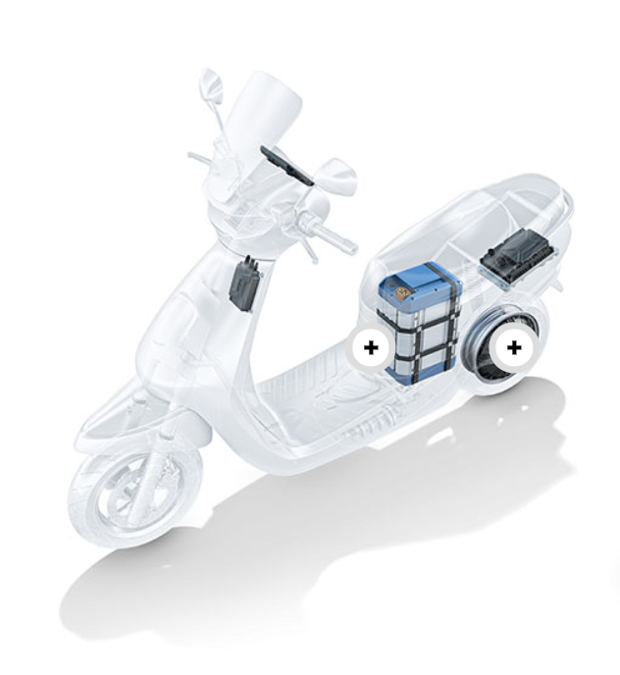
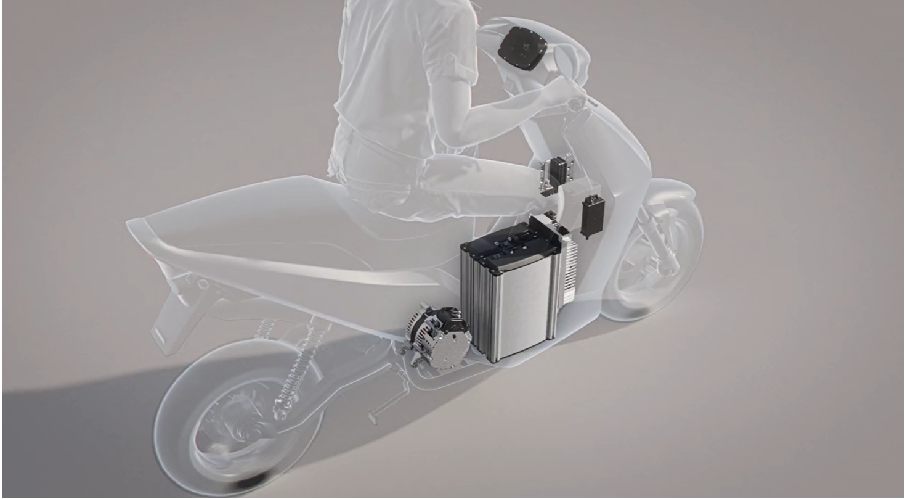
E/E Architecture

Slide 25
THANK YOU.

